Slide 1


End-to-End Encrypted LAN Chat Application
A secure chat application built with Python, demonstrating core networking and cryptography principles. This project allows users on a local network to communicate confidentially and with integrity.
B. Sai Shashank – 1602-23-737-165
Ch. Thrilochan – 1602-23-737-187
K. Vibhas Reddy – 1602-23-737-189
Notes:
1

Slide 2





Application Overview
Core Concepts
Cryptography Focus
Illustrates client-server model, TCP sockets, threading, and secure message handling.
Employs AES encryption for confidentiality and SHA-256 for key derivation.
Key Features
Multi-client support, user identification, and end-to-end encryption.
Notes:
2

Slide 3
Architectural Components
The application consists of three main Python components working in harmony to provide a secure chat experience.
Server (server.py)
Client (client.py)
Crypto Module (crypto.py)
Python sockets & threading
Python sockets & terminal UI
Relays encrypted messages (ciphertext only)
Connects to server, provides username
Provides AES-EAX encryption/decryption
Listens on port 8000 for client connections
Encrypts outgoing, decrypts incoming messages
SHA-256 for key derivation (password to 256-bit AES key)
Uses message framing with length prefixes
Shared key derived from common password (SHA-256)
EAX mode ensures confidentiality and integrity
Protects against message tampering
Notes:
3

Slide 4




How End-to-End Encryption Works
From key generation to message transmission, understand the secure flow of data.
Key Derivation
All clients use a common password which is hashed via SHA-256 to create a shared 256-bit AES key.
Sending a Message
Plaintext is encrypted using AES-EAX mode by the client, then sent as ciphertext to the server.
Receiving a Message
Ciphertext from the server is decrypted by the client using the shared AES key, revealing the plaintext.
Server's Role
The server acts as a "dumb relay," forwarding only ciphertext without access to the encryption key or plaintext.
Notes:
4

Slide 5
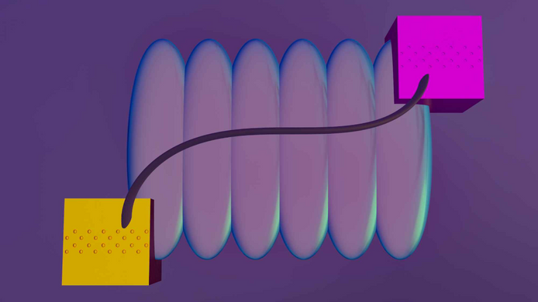
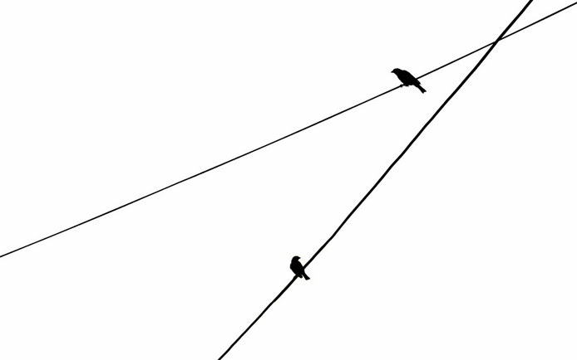
Message Format & Integrity
Encrypted Message Structure
Each message payload contains vital components for secure and reliable transmission:
Nonce (16 bytes): A unique random value for each encryption operation, crucial for security.
Tag (16 bytes): An authentication tag generated by AES-EAX to verify message integrity and authenticity.
Ciphertext: The actual encrypted message, including the username and the chat content.
Network Transmission Framing
To ensure reliable data transfer over TCP streams, a message framing protocol is used:
Length Prefix (4 bytes): Specifies the size of the encrypted payload in big-endian format, allowing the receiver to read the exact amount of data.
Payload: Contains the full encrypted message (Nonce + Tag + Ciphertext).
Notes:
5

Slide 6
Setup & Wireshark Verification
Get the application running and verify encryption using Wireshark to observe network traffic.
01
02
03
Install Dependencies
Start Server
Connect Clients
pip install pycryptodome
python server.py
python client.py
Ensures all cryptographic libraries are available.
Launches the chat server, listening for client connections.
Multiple clients connect, providing username and the shared password.
04
05
Capture with Wireshark
Analyze Packets
sudo wireshark
Observe the TCP stream: you'll see binary data (ciphertext), confirming encryption, rather than readable plaintext.
Start capturing on the loopback interface with filter tcp.port == 8000.
Notes:
6

Slide 7

Security Considerations
While robust for demonstration, real-world applications require addressing further security aspects.
What This Provides
Confidentiality
Integrity
End-to-End
Messages are securely encrypted with AES-256.
EAX mode authentication prevents message tampering.
The server cannot read the plaintext content.
Notes:
7

Slide 8
